Slide 1
Community Wellbeing Toolkit
Feeling Safe,
Self Care,
and Getting Support.
Version 1 – 08/08/24

Slide 2
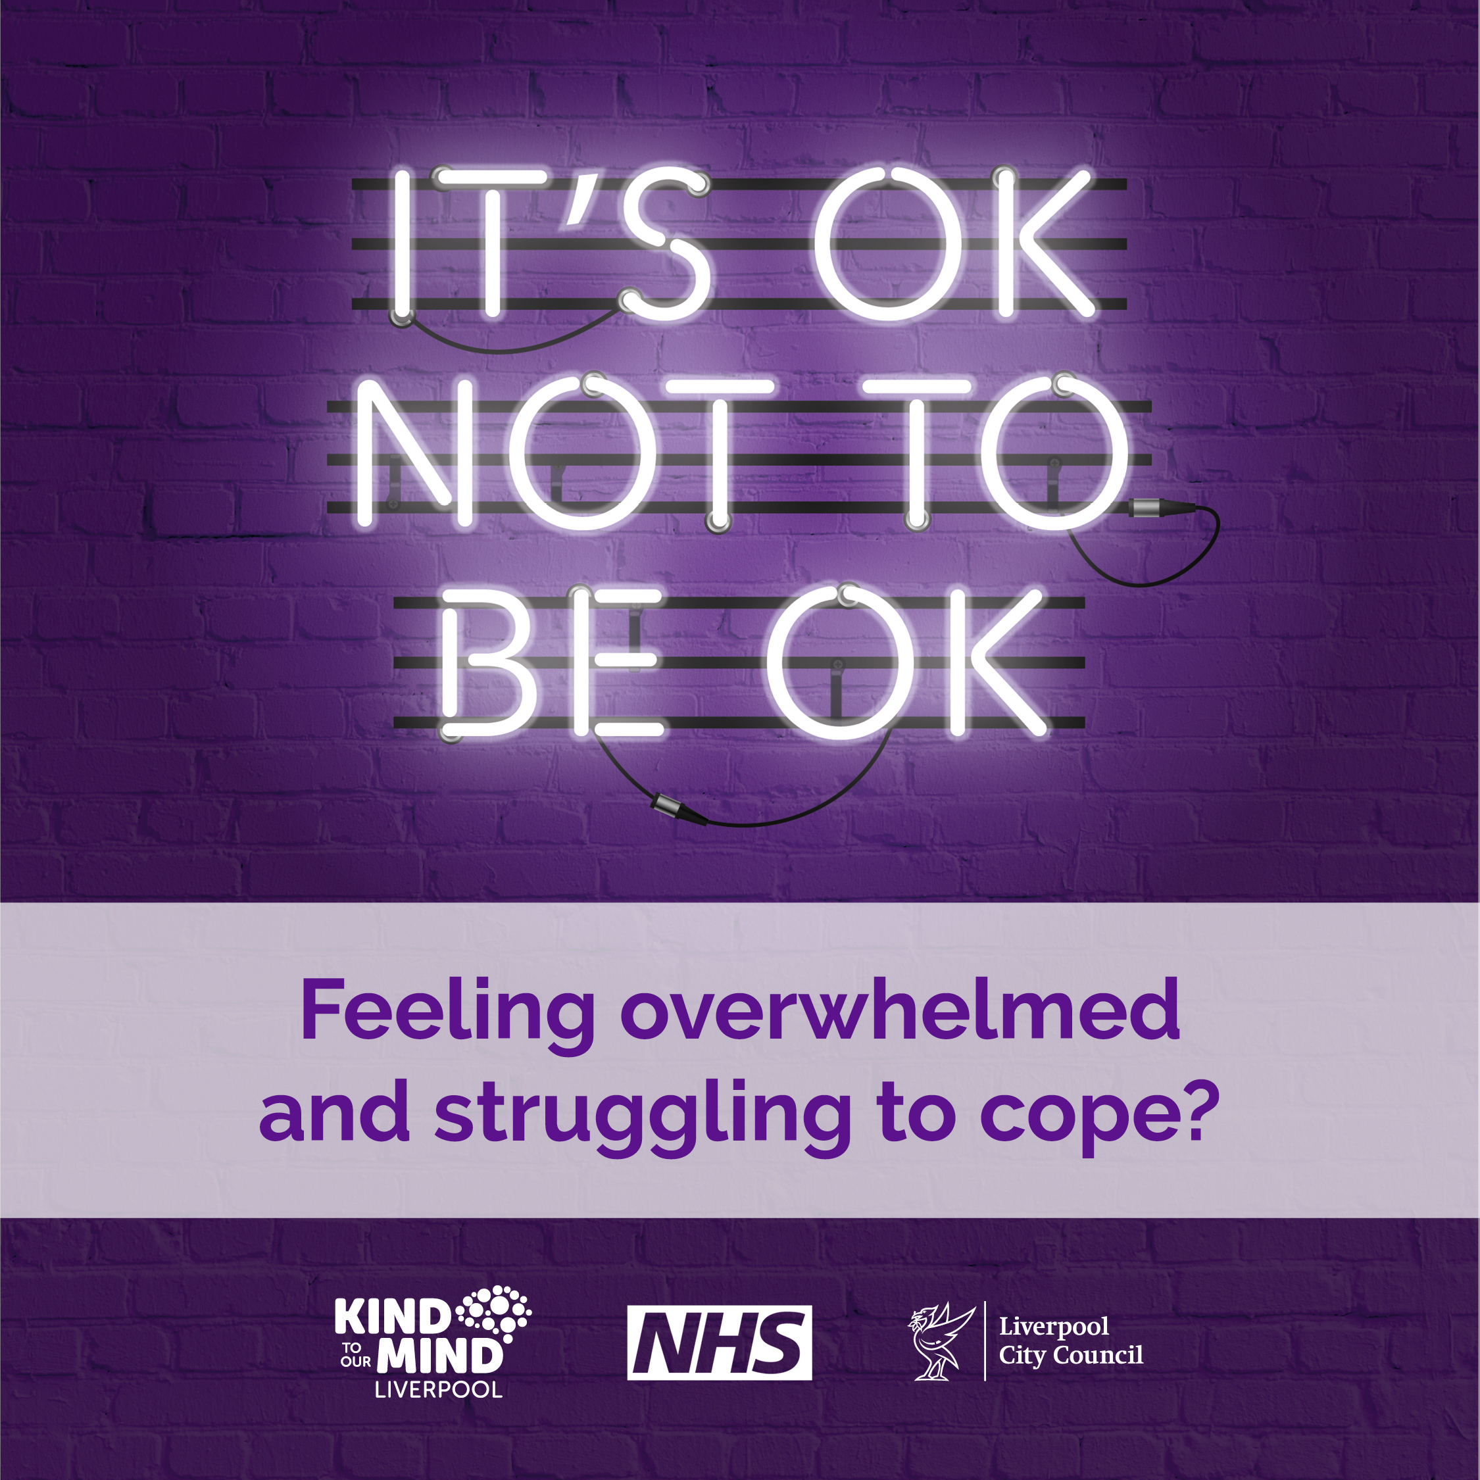
Difficult or Traumatic Events
Everyone responds differently to difficult or traumatic events.
Witnessing conflict or acts of violence is upsetting for most people and can be traumatic for some.
After a very upsetting or traumatic event, it’s not uncommon to experience:
  Bad dreams, flashbacks, intrusive thoughts
  Difficult feelings: upset, worry, fear, anger, guilt, shame
  Negative thoughts about self or others including blame
  Acting differently: not wanting to go out or unable to enjoy things
  Relationship changes: feeling detached or guarded against others
These feelings and symptoms are often temporary but sometimes they persist and can lead to mental health problems like post Traumatic Stress Disorder (PTSD), Anxiety or Depression – and for those that do, there is help available.
Most people find that the negative effects go away over time and there are ways to self-help and feel better sooner.
Version 1 – 08/08/24

Slide 3
How to feel better.
Give yourself time…
Friends, family or others you trust will usually want to help and support if they know you’re struggling, being with others helps you feel protected and supported and more able to avoid poor mental health.
Stick to your routine…
Try to keep doing the things you would normally do, even if that feels difficult – you have the right to feel safe in your community and carry on with your usual daily activities.
It doesn’t help to avoid talking about difficult experiences.
Ask for support…
Recovering from these thoughts and feelings can take time.
Talk about it…
Don’t put yourself under too much pressure to feel better immediately.
Talking to someone you trust about what happened and your feelings about it can help you to feel better – it could help them too if they are going through the same.
Eating well, moving around, getting enough sleep and taking care of our responsibilities are all part of self-care and essential to mental health and wellbeing.
People around us can offer emotional support, help with practical tasks or just spending time doing normal things - all help improve our mood.
Listening to how someone feels can make a big difference.
Version 1 – 08/08/24

Slide 4
When to get help
Everyone deals with difficult events differently, many people recover with support from friends, family and community and while it’s not uncommon to still feel upset from time to time it’s important to know the signs that you or someone you know may need more support.
Feeling the same or worse over time?
It might be a sign to get help if you continue to feel very bad for more than a few weeks and don’t seem to be getting better.
Feeling down?
If you’re feeling sad or anxious most of the time, unable to sleep or think clearly, it’s ok to ask for help.
Feelings getting in the way?
If you don’t feel interested or able to do or enjoy the things you normally would, you should think about getting help.
Feeling overwhelmed?
It’s important to get help as soon as possible if at any point you feel unable to cope.
For more information about getting help and support during difficult times visit:
https://kindtoyourmindliverpool.co.uk/difficult-or-traumatic-events/
Version 1 – 08/08/24

Slide 5
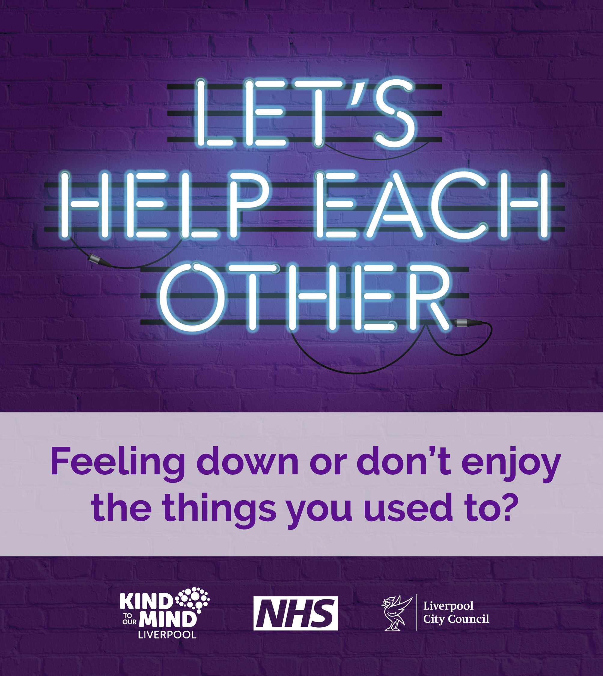
How can I support someone?
There’s lots you can do as a friend, family, community member or supporter of someone affected by difficult events:
Be there – offer to spend time and if they refuse, remind them you’re still there if they change their mind because talking and connecting is always helpful.
Listen – respect when someone doesn’t want to share, but if they do, try not to interrupt or feel you need to advise or share your own experiences, just listening makes a big difference!
Ask how you can help – offer to help them find extra support or someone to talk to if they need it. Practical support like some help around the house, shopping or preparing meals can be a huge relief to someone who is struggling.
If you are really concerned don’t be afraid to ask…
Are you thinking about self-harm or suicide?
Do you need immediate help?
Visit Reach Out Liverpool to find out more.
Version 1 – 08/08/24

Slide 6
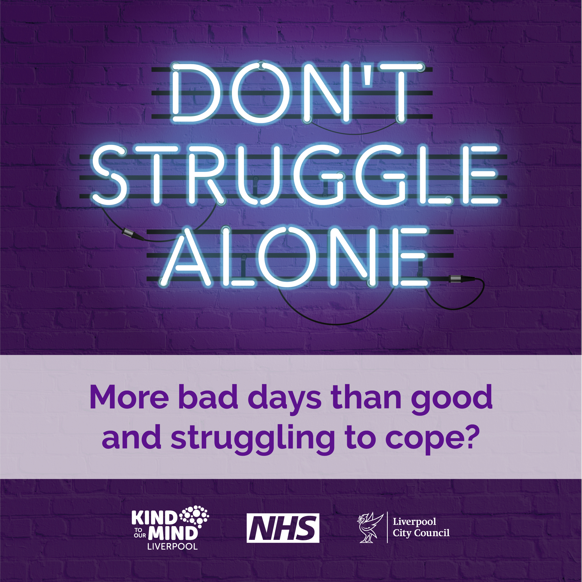
Help and support in Liverpool and Wirral
Anyone needing support following the Water Street Incident can contact Victim Care Merseyside , Call 0808 175 3080 between 8am and 6pm.
Your GP can help with mental health and wellbeing, and connect you with available support.
For 24-Hour listening support call Samaritans on 116 123 www.samaritans.org
For immediate text-based support text SHOUT to 85258
Local Libraries provide a warm and welcoming place of sanctuary, advice and support for anyone looking to feel safer or be with others during difficult times: Find a library
Visit Kind to your Mind where you can access a range of mental health and wellbeing services and resources within Wirral, including tips, advice, apps and online courses. Find support today by either creating a personal support plan or searching for services yourself
NHS Talking Therapies offer support to anyone who is struggling following recent events.
Get in touch on 0151 649 1859 or via the website: NHS Wirral Talking Therapies | Everyturn
Anyone in need of immediate support with a mental health crisis can call 111 and select the mental health option to access urgent mental health support.
For Emergency Help - If you or someone you know is in immediate danger dial 999
Version 1 – 08/08/24

Slide 7
Version 1 – 08/08/24

